Slide 1
Mechanisms and Robotics DE ZG561
Lecture - 9

Slide 2
Differential Motion and Jacobian
Differential Motion and Jacobian
θ – r Manipulator
R – R Manipulator
3 dof Articulated Manipulator

Slide 3
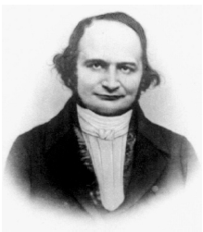
Jacobian - History
Carl Gustav Jacob Jacobi (1804–1851) was a Prussian mathematician. He obtained a Doctor of Philosophy degree from Berlin University in 1825. In 1827 he was appointed professor of mathematics at Königsberg University and held this position until 1842.
Jacobi wrote a classic treatise on elliptic functions in 1829 and also described the derivative of m functions of n variables which bears his name. He was elected a foreign member of the Royal Swedish Academy of Sciences in 1836.

Slide 4
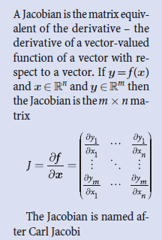
Jacobian
A Jacobian relates velocities in joint space to velocities in Cartesian space.

Slide 6
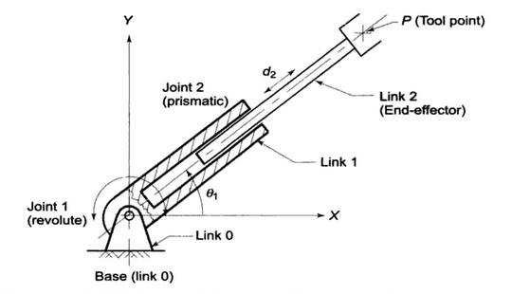
θ – r Manipulator

Slide 7
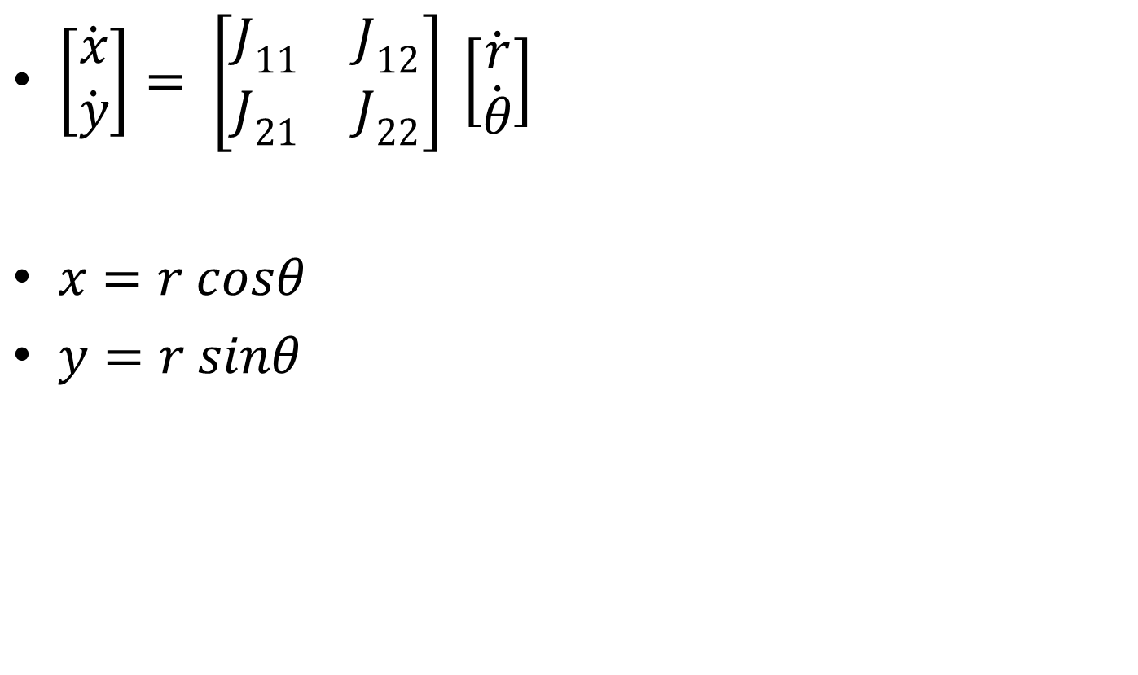
θ – r Manipulator
$\left[\begin{matrix}\dot{x} \\ \dot{y}\end{matrix}\right]= \left[\begin{matrix}J_{11} & J_{12} \\ J_{21} & J_{22}\end{matrix}\right] \left[\begin{matrix}\dot{r} \\ \dot{θ}\end{matrix}\right]$
$x=r cosθ$
$y=r sinθ$

Slide 8
θ – r Manipulator

Slide 9
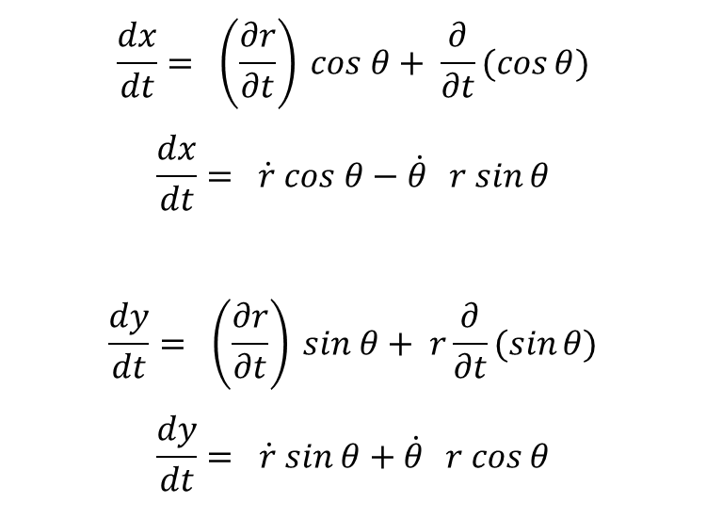
θ – r Manipulator
$$\frac{dx}{dt}= \left(\frac{∂r}{∂t}\right) cos θ+ \frac{∂}{∂t}(\cos{θ)}$$
$$\frac{dx}{dt}= \dot{r} cos θ−\dot{θ} r sin{θ}$$
$$\frac{dy}{dt}= \left(\frac{∂r}{∂t}\right) sin θ+ r\frac{∂}{∂t}(\sin{θ)}$$
$$\frac{dy}{dt}= \dot{r} sin θ+\dot{θ} r cos{θ}$$

Slide 10
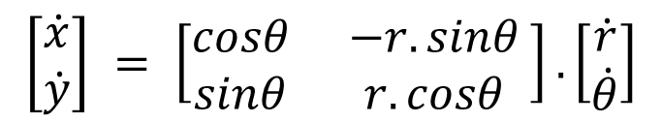
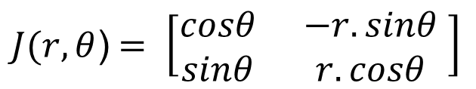
θ – r Manipulator
$$\left[\begin{matrix}\dot{x} \\ \dot{y}\end{matrix}\right] = \left[\begin{matrix}cosθ & −r.sinθ \\ sinθ & r.cosθ \end{matrix}\right]. \left[\begin{matrix}\dot{r} \\ \dot{θ}\end{matrix}\right]$$
$J(r,θ$)$= \left[\begin{matrix}cosθ & −r.sinθ \\ sinθ & r.cosθ \end{matrix}\right]$

Slide 11
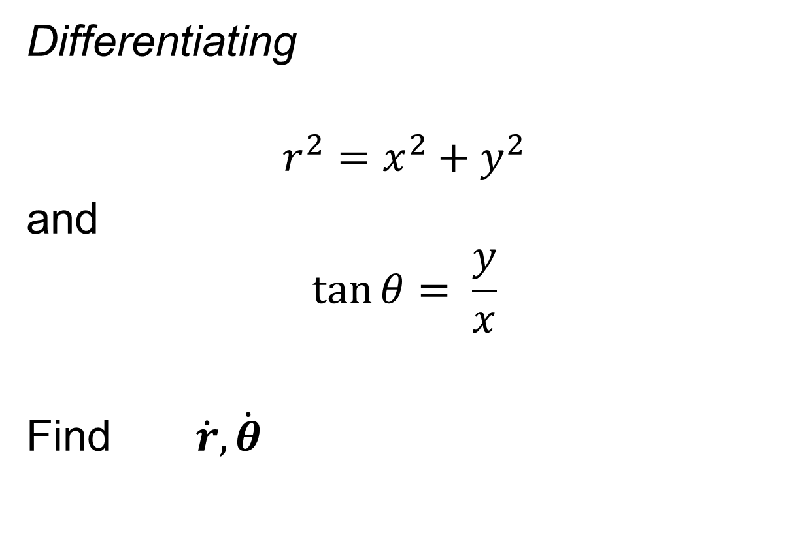
Jacobian Inverse
Differentiating
$$r^{2}=x^{2}+y^{2}$$
and
$$\tan{θ}= \frac{y}{x}$$
Find $\dot{r}, \dot{θ}$

Slide 12
Jacobian Inverse

Slide 13
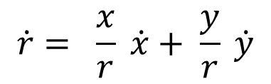
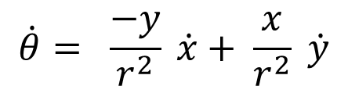
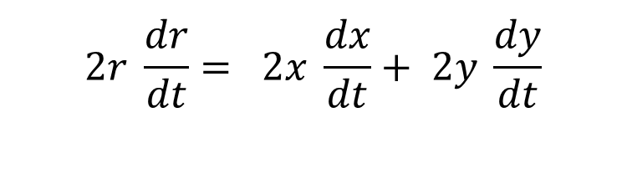
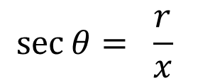
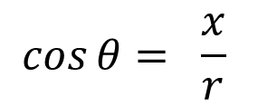
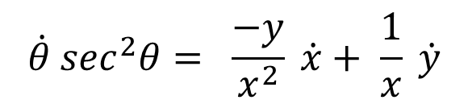
$$2r \frac{dr}{dt}= 2x \frac{dx}{dt}+ 2y \frac{dy}{dt}$$
$$\cos{θ}= \frac{x}{r}$$
$$\dot{r}= \frac{x}{r} \dot{x}+ \frac{y}{r} \dot{y}$$
$$\sec{θ}= \frac{r}{x}$$
$$\dot{θ}\sec^{2}θ= \frac{−y}{x^{2}} \dot{x}+ \frac{1}{x} \dot{y}$$
$$\dot{θ}= \frac{−y}{r^{2}} \dot{x}+ \frac{x}{r^{2}} \dot{y}$$

Slide 14
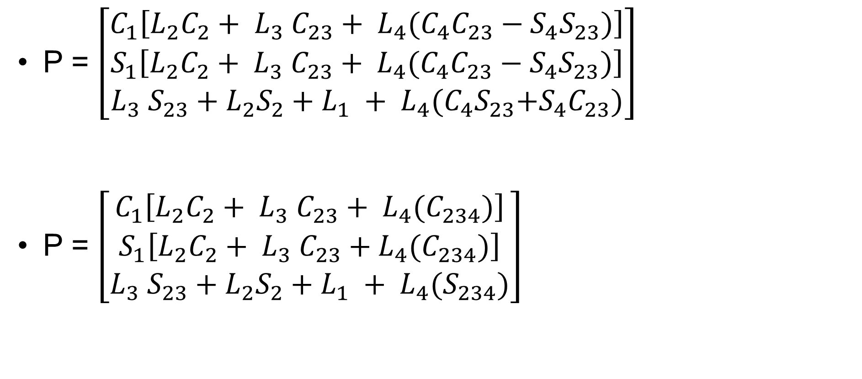
Jacobian Inverse
$\left[\begin{matrix}\dot{r} \\ \dot{θ}\end{matrix}\right]= \left[\begin{matrix}\frac{x}{r} & \frac{y}{r} \\ \frac{−y}{r^{2}} & \frac{x}{r^{2}}\end{matrix}\right] \left[\begin{matrix}\dot{x} \\ \dot{y}\end{matrix}\right]$

Slide 15
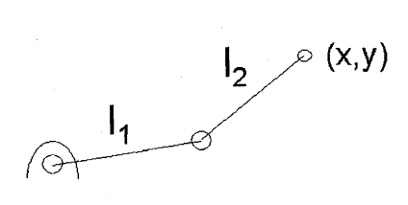
Jacobian of an RR Manipulator

Slide 16
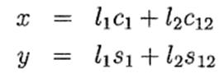
Jacobian of an RR Manipulator

Slide 18
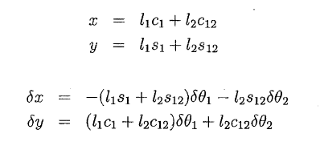
Jacobian of an RR Manipulator

Slide 19
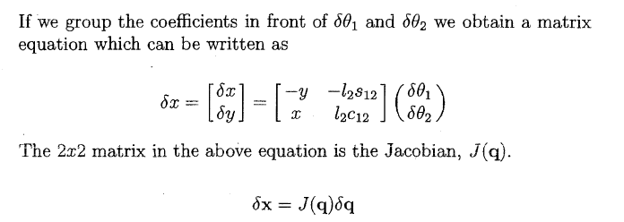
Jacobian of an RR Manipulator

Slide 20

Jacobian of an RR Manipulator

Slide 22
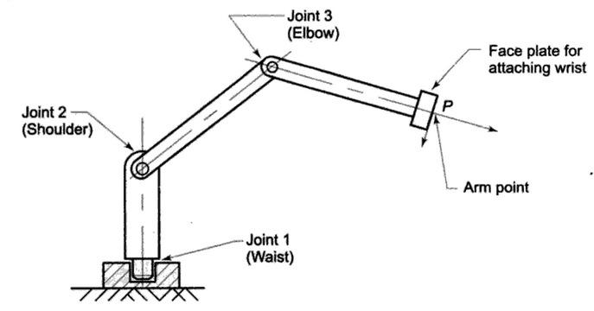
Tool Configuration Jacobian of a 3 dof arm

Slide 23
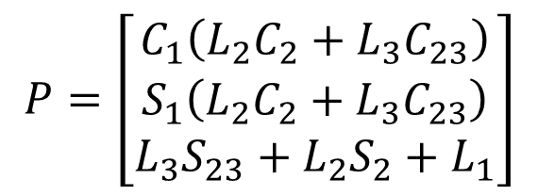
Tool point
$$P=\left[\begin{matrix}C_{1}\left(L_{2}C_{2}+L_{3}C_{23}\right) \\ S_{1}\left(L_{2}C_{2}+L_{3}C_{23}\right) \\ L_{3}S_{23}+L_{2}S_{2}+L_{1}\end{matrix}\right]$$

Slide 24
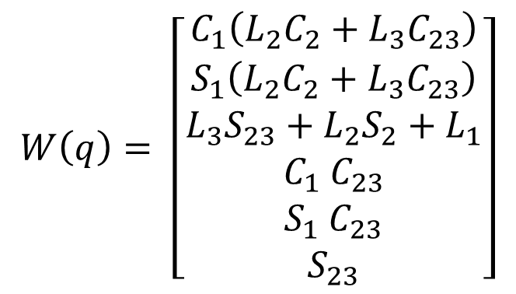
Finding the Jacobian
Tool configuration function of the manipulator is given as
$$W\left(q\right)= \left[\begin{matrix}C_{1}\left(L_{2}C_{2}+L_{3}C_{23}\right) \\ \begin{matrix}S_{1}\left(L_{2}C_{2}+L_{3}C_{23}\right) \\ L_{3}S_{23}+L_{2}S_{2}+L_{1} \\ {C_{1} C}_{23}\end{matrix} \\ \begin{matrix}{S_{1} C}_{23} \\ S_{23}\end{matrix}\end{matrix}\right]$$
Tool position vector
Tool orientation vector

Slide 25
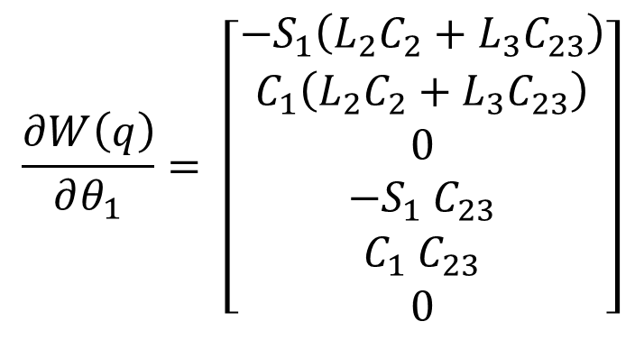
$$\frac{∂W\left(q\right)}{∂θ_{1}}= \left[\begin{matrix}−S_{1}\left(L_{2}C_{2}+L_{3}C_{23}\right) \\ \begin{matrix}C_{1}\left(L_{2}C_{2}+L_{3}C_{23}\right) \\ 0 \\ {{−S}_{1} C}_{23}\end{matrix} \\ \begin{matrix}{C_{1} C}_{23} \\ 0\end{matrix}\end{matrix}\right]$$

Slide 26
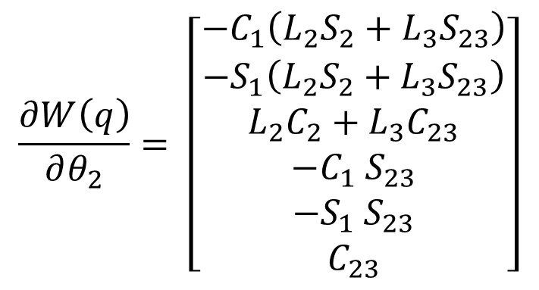
$$\frac{∂W\left(q\right)}{∂θ_{2}}= \left[\begin{matrix}−C_{1}\left(L_{2}S_{2}+L_{3}S_{23}\right) \\ \begin{matrix}{−S}_{1}\left(L_{2}S_{2}+L_{3}S_{23}\right) \\ L_{2}C_{2}+L_{3}C_{23} \\ {{−C}_{1} S}_{23}\end{matrix} \\ \begin{matrix}{{−S}_{1} S}_{23} \\ C_{23}\end{matrix}\end{matrix}\right]$$

Slide 27
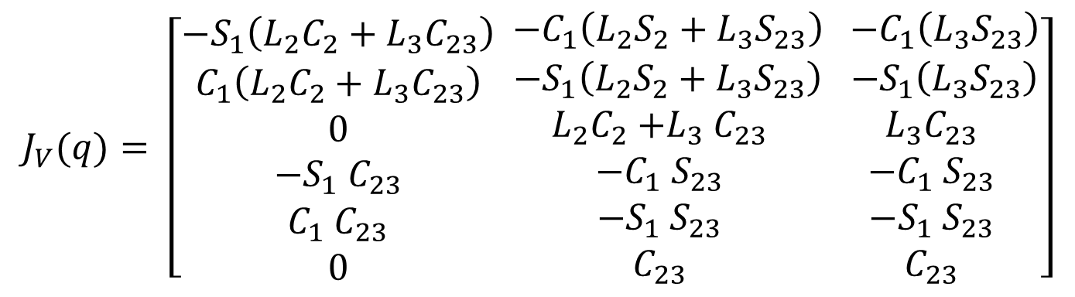
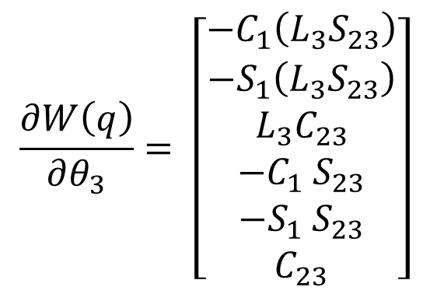
$$\frac{∂W\left(q\right)}{∂θ_{3}}= \left[\begin{matrix}−C_{1}\left(L_{3}S_{23}\right) \\ \begin{matrix}{−S}_{1}\left(L_{3}S_{23}\right) \\ L_{3}C_{23} \\ {{−C}_{1} S}_{23}\end{matrix} \\ \begin{matrix}{{−S}_{1} S}_{23} \\ C_{23}\end{matrix}\end{matrix}\right]$$
$$J_{V}(q)= \left[\begin{matrix}−S_{1}\left(L_{2}C_{2}+L_{3}C_{23}\right) \\ \begin{matrix}C_{1}\left(L_{2}C_{2}+L_{3}C_{23}\right) \\ 0 \\ {{−S}_{1} C}_{23}\end{matrix} \\ \begin{matrix}{C_{1} C}_{23} \\ 0\end{matrix}\end{matrix}\begin{matrix} −C_{1}\left(L_{2}S_{2}+L_{3}S_{23}\right) \\ \begin{matrix}{ −S}_{1}\left(L_{2}S_{2}+L_{3}S_{23}\right) \\ L_{2}C_{2}{+L}_{3}C_{23} \\ {{−C}_{1} S}_{23}\end{matrix} \\ \begin{matrix}{{−S}_{1} S}_{23} \\ C_{23}\end{matrix}\end{matrix}\begin{matrix} −C_{1}\left(L_{3}S_{23}\right) \\ \begin{matrix}{ −S}_{1}\left(L_{3}S_{23}\right) \\ L_{3}C_{23} \\ {{−C}_{1} S}_{23}\end{matrix} \\ \begin{matrix}{{−S}_{1} S}_{23} \\ C_{23}\end{matrix}\end{matrix}\right]$$

Slide 28
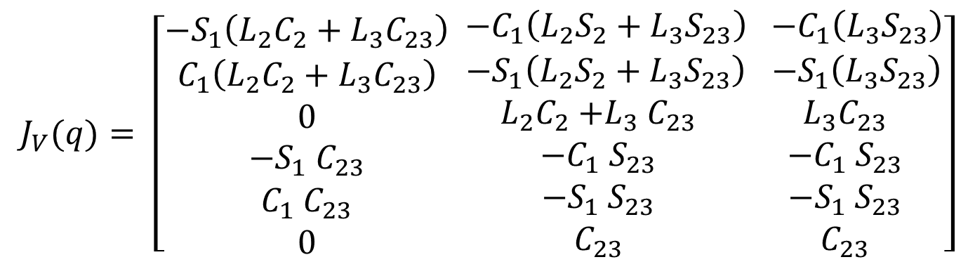
Tool Configuration Jacobian
$$J_{V}(q)= \left[\begin{matrix}−S_{1}\left(L_{2}C_{2}+L_{3}C_{23}\right) \\ \begin{matrix}C_{1}\left(L_{2}C_{2}+L_{3}C_{23}\right) \\ 0 \\ {{−S}_{1} C}_{23}\end{matrix} \\ \begin{matrix}{C_{1} C}_{23} \\ 0\end{matrix}\end{matrix}\begin{matrix} −C_{1}\left(L_{2}S_{2}+L_{3}S_{23}\right) \\ \begin{matrix}{ −S}_{1}\left(L_{2}S_{2}+L_{3}S_{23}\right) \\ L_{2}C_{2}{+L}_{3}C_{23} \\ {{−C}_{1} S}_{23}\end{matrix} \\ \begin{matrix}{{−S}_{1} S}_{23} \\ C_{23}\end{matrix}\end{matrix}\begin{matrix} −C_{1}\left(L_{3}S_{23}\right) \\ \begin{matrix}{ −S}_{1}\left(L_{3}S_{23}\right) \\ L_{3}C_{23} \\ {{−C}_{1} S}_{23}\end{matrix} \\ \begin{matrix}{{−S}_{1} S}_{23} \\ C_{23}\end{matrix}\end{matrix}\right]$$

Slide 29
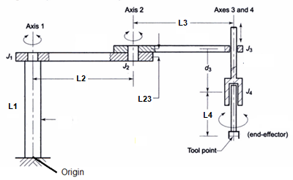
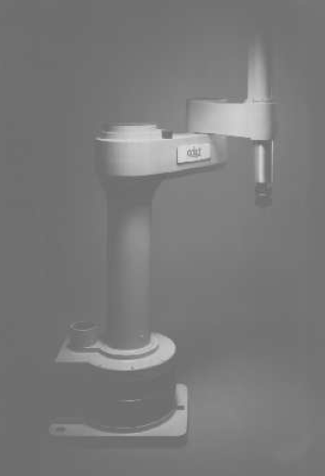
Tool Configuration Jacobian of a 4 axis SCARA

Slide 30
4 axis SCARA
P = $\left[\begin{matrix}L_{2}.cosθ_{1}+ L_{3}.cos{(θ}_{1}+θ_{2}) \\ L_{2}. sinθ_{1}+ L_{3}. sin{(θ}_{1}+θ_{2}) \\ L_{1} + L_{23}− d_{3}− L_{4}\end{matrix}\right]$

Slide 31
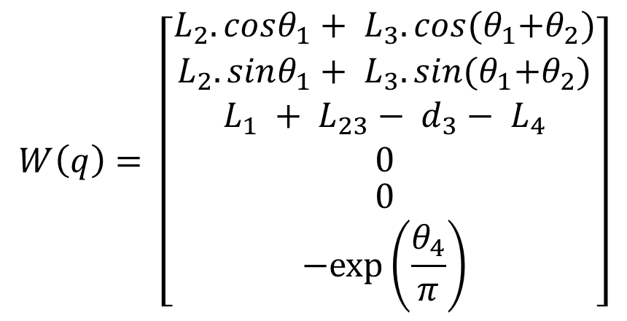
4 axis SCARA
Tool configuration function is given as
$$W\left(q\right)= \left[\begin{matrix}L_{2}.cosθ_{1}+ L_{3}.cos{(θ}_{1}+θ_{2}) \\ \begin{matrix}L_{2}. sinθ_{1}+ L_{3}. sin{(θ}_{1}+θ_{2}) \\ L_{1} + L_{23}− d_{3}− L_{4} \\ 0\end{matrix} \\ \begin{matrix}0 \\ −exp⁡\left(\frac{θ_{4}}{π}\right)\end{matrix}\end{matrix}\right]$$

Slide 32
Finding the Tool Configuration Jacobian
$$\frac{∂W\left(q\right)}{∂θ_{1}}= \left[\begin{matrix}−L_{2}{Sinθ}_{1}−L_{3}{Sin(θ}_{1}+θ_{2}) \\ \begin{matrix}L_{2}{Cosθ}_{1}+L_{3}{Cos(θ}_{1}+θ_{2}) \\ 0 \\ 0\end{matrix} \\ \begin{matrix}0 \\ 0\end{matrix}\end{matrix}\right]$$

Slide 33
Finding the Tool Configuration Jacobian
$$\frac{∂W\left(q\right)}{∂θ_{2}}= \left[\begin{matrix}−L_{3}{Sin(θ}_{1}+θ_{2}) \\ \begin{matrix}L_{3}{Cos(θ}_{1}+θ_{2}) \\ 0 \\ 0\end{matrix} \\ \begin{matrix}0 \\ 0\end{matrix}\end{matrix}\right]$$

Slide 34
Finding the Tool Configuration Jacobian
$$\frac{∂W\left(q\right)}{∂d_{3}}= \left[\begin{matrix}0 \\ \begin{matrix}0 \\ −1 \\ 0\end{matrix} \\ \begin{matrix}0 \\ 0\end{matrix}\end{matrix}\right]$$

Slide 35
Finding the Tool Configuration Jacobian
$$\frac{∂W\left(q\right)}{∂θ_{4}}= \left[\begin{matrix}0 \\ \begin{matrix}0 \\ 0 \\ 0\end{matrix} \\ \begin{matrix}0 \\ −\exp\left(\frac{θ_{4}}{π}\right)/π\end{matrix}\end{matrix}\right]$$

Slide 36
Tool Configuration Jacobian of a 4 dof SCARA
$$J_{V}(q)= \left[\begin{matrix}−L_{2}{Sinθ}_{1}−L_{3}{Sin(θ}_{1}+θ_{2}) \\ \begin{matrix}L_{2}{Cosθ}_{1}+L_{3}{Cos(θ}_{1}+θ_{2}) \\ 0 \\ 0\end{matrix} \\ \begin{matrix}0 \\ 0\end{matrix}\end{matrix}\begin{matrix}−L_{3}{Sin(θ}_{1}+θ_{2}) \\ \begin{matrix}L_{3}{Cos(θ}_{1}+θ_{2}) \\ 0 \\ 0\end{matrix} \\ \begin{matrix}0 \\ 0\end{matrix}\end{matrix}\begin{matrix}0 \\ \begin{matrix}0 \\ −1 \\ 0\end{matrix} \\ \begin{matrix}0 \\ 0\end{matrix}\end{matrix}\begin{matrix}0 \\ \begin{matrix}0 \\ 0 \\ 0\end{matrix} \\ \begin{matrix}0 \\ −\exp\left(\frac{θ_{4}}{π}\right)/π\end{matrix}\end{matrix}\right]$$

Slide 37
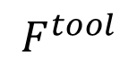
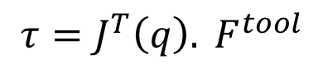
Manipulator Jacobian
Let J(q) be the manipulator Jacobian matrix of a robotic arm with frictionless joints.
The internal joint torque and force vector τ induced by an external end-of-arm force and moment vector is
$$F^{tool}$$
$${τ=J^{T}\left(q\right). F}^{tool}$$

Slide 38
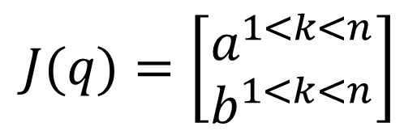
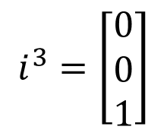
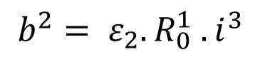
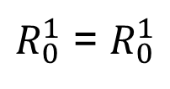
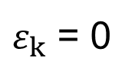
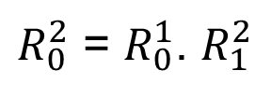
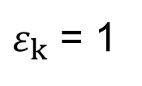
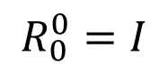
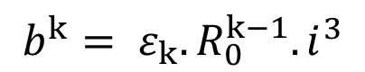
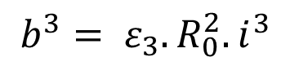
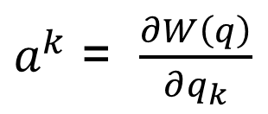
Manipulator Jacobian of a 3 dof Articulated arm
$$J(q)=\left[\begin{matrix}a^{1<k<n} \\ b^{1<k<n}\end{matrix}\right]$$
$a^{k}$ = $\frac{∂W\left(q\right)}{∂q_{k}}$
$$b^{k}= ε_{k}. R_{0}^{k−1}. i^{3}$$
$$i^{3}=\left[\begin{matrix}0 \\ 0 \\ 1\end{matrix}\right]$$
$$b^{1}= ε_{1}. R_{0}^{0}. i^{3}$$
$$R_{0}^{0}=I$$
$$b^{2}= ε_{2}. R_{0}^{1} . i^{3}$$
$R_{0}^{1}$ = $R_{0}^{1}$
$ε_{k}$ = 1
Revolute Joint
$$b^{3}= ε_{3}. R_{0}^{2}. i^{3}$$
$R_{0}^{2}$ = $R_{0}^{1}$. $R_{1}^{2}$
$ε_{k}$ = 0
Prismatic Joint

Slide 39
Tool Configuration Jacobian of a 3 dof arm

Slide 40
Tool point
$$P=\left[\begin{matrix}C_{1}\left(L_{2}C_{2}+L_{3}C_{23}\right) \\ S_{1}\left(L_{2}C_{2}+L_{3}C_{23}\right) \\ L_{3}S_{23}+L_{2}S_{2}+L_{1}\end{matrix}\right]$$

Slide 41
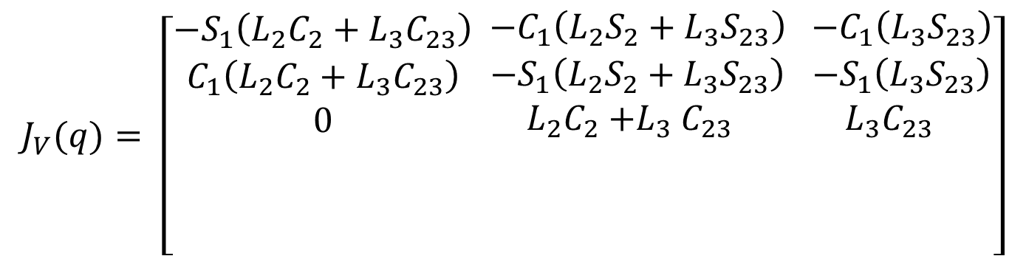
Tool Configuration Jacobian
$$J_{V}(q)= \left[\begin{matrix}−S_{1}\left(L_{2}C_{2}+L_{3}C_{23}\right) \\ \begin{matrix}C_{1}\left(L_{2}C_{2}+L_{3}C_{23}\right) \\ 0 \\ \end{matrix} \\ \begin{matrix} \\ \end{matrix}\end{matrix}\begin{matrix} −C_{1}\left(L_{2}S_{2}+L_{3}S_{23}\right) \\ \begin{matrix}{ −S}_{1}\left(L_{2}S_{2}+L_{3}S_{23}\right) \\ L_{2}C_{2}{+L}_{3}C_{23} \\ \end{matrix} \\ \begin{matrix} \\ \end{matrix}\end{matrix}\begin{matrix} −C_{1}\left(L_{3}S_{23}\right) \\ \begin{matrix}{ −S}_{1}\left(L_{3}S_{23}\right) \\ L_{3}C_{23} \\ \end{matrix} \\ \begin{matrix} \\ \end{matrix}\end{matrix}\right]$$

Slide 42
Manipulator Jacobian of a 3 dof Articulated arm
$$J(q)=\left[\begin{matrix}a^{1<k<n} \\ b^{1<k<n}\end{matrix}\right]$$
$a^{k}$ = $\frac{∂W\left(q\right)}{∂q_{k}}$
$$b^{k}= ε_{k}. R_{0}^{k−1}. i^{3}$$
$$i^{3}=\left[\begin{matrix}0 \\ 0 \\ 1\end{matrix}\right]$$
$$b^{1}= ε_{1}. R_{0}^{0}. i^{3}$$
$$R_{0}^{0}=I$$
$$b^{2}= ε_{2}. R_{0}^{1} . i^{3}$$
$R_{0}^{1}$ = $R_{0}^{1}$
$ε_{k}$ = 1
Revolute Joint
$$b^{3}= ε_{3}. R_{0}^{2}. i^{3}$$
$R_{0}^{2}$ = $R_{0}^{1}$. $R_{1}^{2}$
$ε_{k}$ = 0
Prismatic Joint

Slide 43
Tool Configuration Jacobian
$$J_{V}(q)= \left[\begin{matrix}−S_{1}\left(L_{2}C_{2}+L_{3}C_{23}\right) \\ \begin{matrix}C_{1}\left(L_{2}C_{2}+L_{3}C_{23}\right) \\ 0 \\ {{−S}_{1} C}_{23}\end{matrix} \\ \begin{matrix}{C_{1} C}_{23} \\ 0\end{matrix}\end{matrix}\begin{matrix} −C_{1}\left(L_{2}S_{2}+L_{3}S_{23}\right) \\ \begin{matrix}{ −S}_{1}\left(L_{2}S_{2}+L_{3}S_{23}\right) \\ L_{2}C_{2}{+L}_{3}C_{23} \\ {{−C}_{1} S}_{23}\end{matrix} \\ \begin{matrix}{{−S}_{1} S}_{23} \\ C_{23}\end{matrix}\end{matrix}\begin{matrix} −C_{1}\left(L_{3}S_{23}\right) \\ \begin{matrix}{ −S}_{1}\left(L_{3}S_{23}\right) \\ L_{3}C_{23} \\ {{−C}_{1} S}_{23}\end{matrix} \\ \begin{matrix}{{−S}_{1} S}_{23} \\ C_{23}\end{matrix}\end{matrix}\right]$$

Slide 44
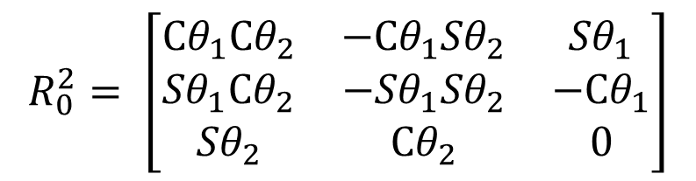
$$R_{0}^{0}= \left[\begin{matrix}1 & 0 & 0 \\ 0 & 1 & 0 \\ 0 & 0 & 1\end{matrix}\right]$$
$$R_{0}^{1}= \left[\begin{matrix}{Cθ}_{1} & 0 & {Sθ}_{1} \\ {Sθ}_{1} & 0 & −{Cθ}_{1} \\ 0 & 1 & 0\end{matrix}\right]$$
$$R_{1}^{2}= \left[\begin{matrix}{Cθ}_{2} & {−Sθ}_{2} & 0 \\ {Sθ}_{2} & {Cθ}_{2} & 0 \\ 0 & 0 & 1\end{matrix}\right]$$
$$R_{0}^{2}= \left[\begin{matrix}{Cθ}_{1}{Cθ}_{2} & {−{Cθ}_{1}Sθ}_{2} & {Sθ}_{1} \\ {Sθ}_{1}{Cθ}_{2} & {−Sθ}_{1}{Sθ}_{2} & −{Cθ}_{1} \\ {Sθ}_{2} & {Cθ}_{2} & 0\end{matrix}\right]$$

Slide 45
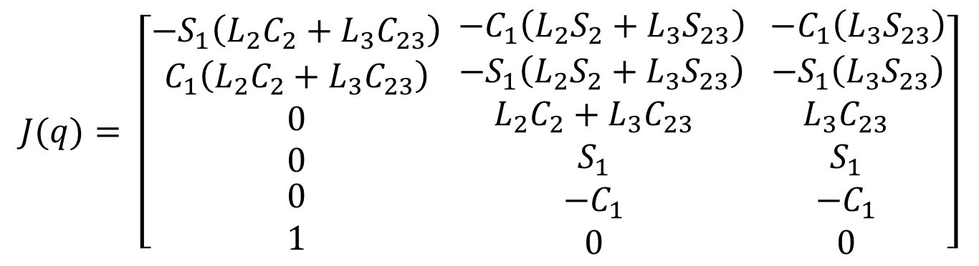
Manipulator Jacobian
$$J(q)= \left[\begin{matrix}−S_{1}\left(L_{2}C_{2}+L_{3}C_{23}\right) \\ \begin{matrix}C_{1}\left(L_{2}C_{2}+L_{3}C_{23}\right) \\ 0 \\ 0\end{matrix} \\ \begin{matrix}0 \\ 1\end{matrix}\end{matrix}\begin{matrix} −C_{1}\left(L_{2}S_{2}+L_{3}S_{23}\right) \\ \begin{matrix}{ −S}_{1}\left(L_{2}S_{2}+L_{3}S_{23}\right) \\ L_{2}C_{2}+L_{3}C_{23} \\ S_{1}\end{matrix} \\ \begin{matrix}{−C}_{1} \\ 0\end{matrix}\end{matrix}\begin{matrix} −C_{1}\left(L_{3}S_{23}\right) \\ \begin{matrix}{ −S}_{1}\left(L_{3}S_{23}\right) \\ L_{3}C_{23} \\ S_{1}\end{matrix} \\ \begin{matrix}{−C}_{1} \\ 0\end{matrix}\end{matrix}\right]$$

Slide 47
THANK YOU
The presenter is grateful to the authors of the following textbooks for their wonderful work.
Industrial Robotics – Mikell P. Groover
Fundamentals of Robotics – Robert Schilling
Industrial Robotics – Wesley Snyder

